Slide 1
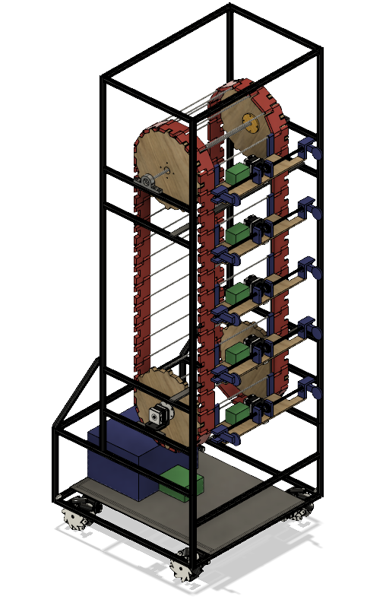
ABC robot

Slide 2
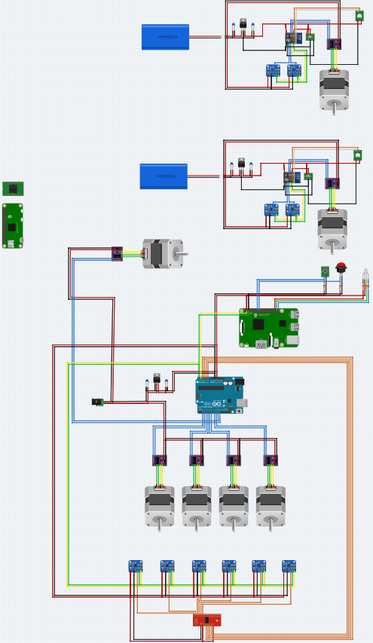

Slide 4
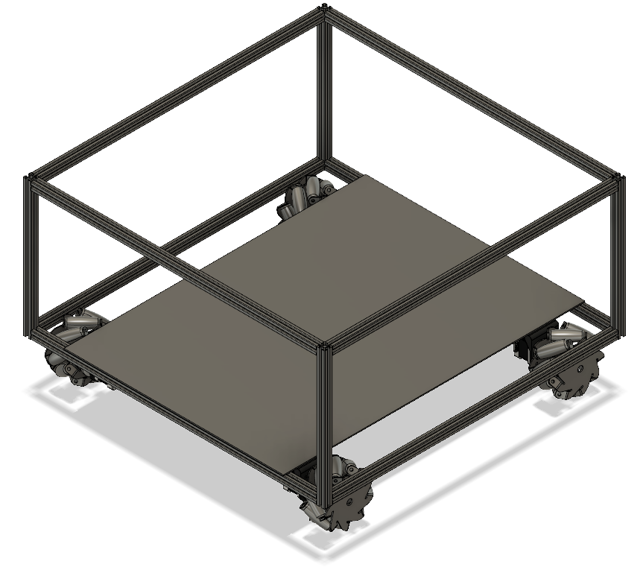

Slide 5
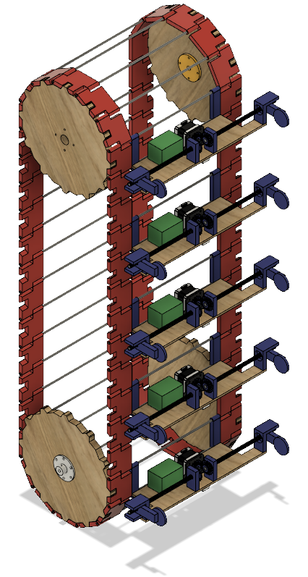

Slide 6
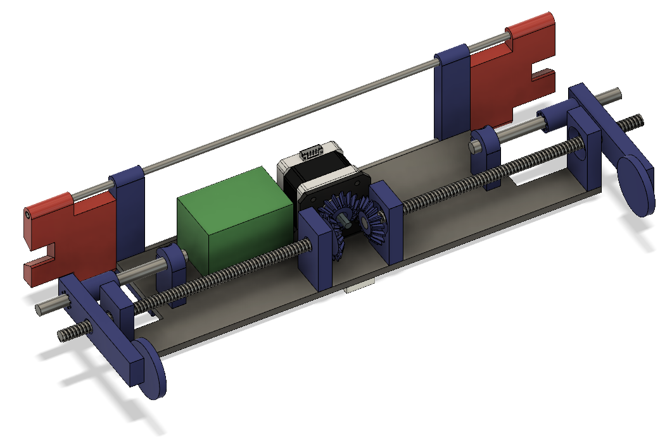

Slide 7
Elektrisch schema

Slide 12
Parts list
4 stepper(wielen)
2 stepper(belt)
6 stepper(klauw)
12 stepper driver
X afstandssensor(VL6180X)
6 ESP8266(WiFi)
1 Arduino
1 rasberryPi
1 rasberryPi zero W +camera
Voltage regulators
12V batterij
6 powerbanks
Buttons
LED’s
USB programmer
switch
MUX

Slide 13
